Slide 1

Branch-and- Bound
Chapter 6

Slide 2
Objectives
Describe the branch-and-bound technique for solving optimization problems
Contrast the branch-and-bound technique for solving problems with the backtracking technique
Identify when it is appropriate to use the branch-and-bound technique to solve a particular problem.
Apply the branch-and bound technique to solve the N-Queen Problem

Slide 3
Objectives
Apply the branch-and-bound technique to solve the 0-1 Knapsack Problem
Apply the branch-and-bound technique to solve the Traveling Salesperson Problem

Slide 4
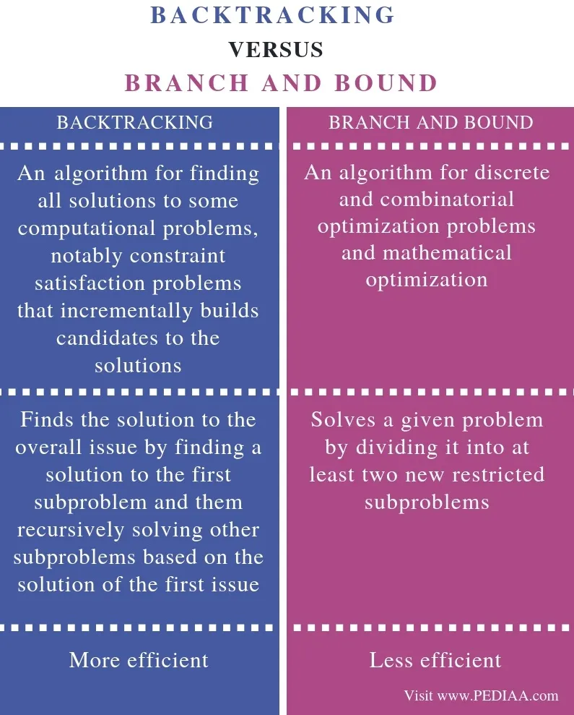

Slide 5
Branch-and-Bound Design Strategy
Branch-and-bound design strategy is similar to backtracking
State space tree used to solve problem
Difference between branch-and-bound and backtracking:
1. branch-and-bound is not limited to a particular tree traversal
2. branch-and-bound is used only for optimization problems

Slide 6
Branch- and-Bound Design Strategy
A branch-and-bound algorithm computes a number (bound) at a node to determine whether the node is promising.
The number is a bound on the value of the solution that could be obtained by expanding beyond the node.
If that bound is no better than the value of the best solution found so far, the node is nonpromising.
Otherwise, it is promising.
Note: by “better” we mean smaller or larger, depending on the problem

Slide 7
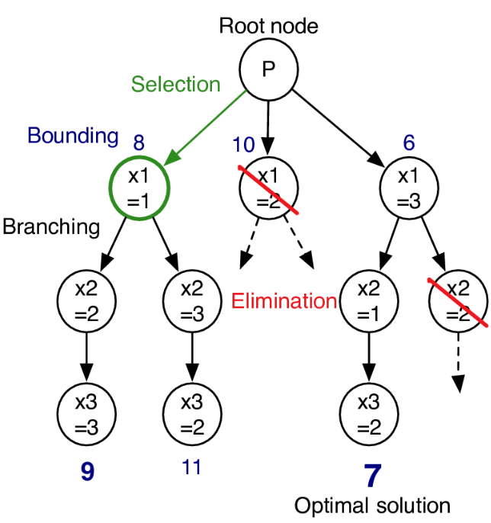

Slide 8
FIFO Queues
First-in first-out (FIFO) queues.
Examples of usage of FIFO queues:
Program execution:
Requests for access to memory, disk, network...
Resource allocation:
Forwarding network traffic in network switches and routers.
Search algorithms.
E.g. part of BFS in Graphs, level-order traversal for trees.
Main operations:
put - inserts an item at the end of the queue.
get - removes the item from the head of the queue.
2 implementations for FIFO queues: single linked list & array

Slide 9
List Implementation for FIFO Queues
A FIFO queue is essentially a list.
put(&queue, item) inserts that item at the end of the list. - O(1)
Assumption: the list data type contains a pointer to the last element.
get(&queue) removes (and returns) the item at the beginning of the list. - O(1)
typedef struct node * nodePT;
struct queue_list {
nodePT first;
nodePT last;
int size;
};
my_queue (struct queue_list)
first (nodePT)
30cd
last (nodePT)
10bd
size (int)
9
30cd
10bd
18
7
3
....
1

Slide 10
Breadth-first Tree Search
Use Queue - FIFO
Visit root first
Visit all nodes at level 1 next
Visit all nodes at level 2 next . . .
Visit all nodes at level n

Slide 11
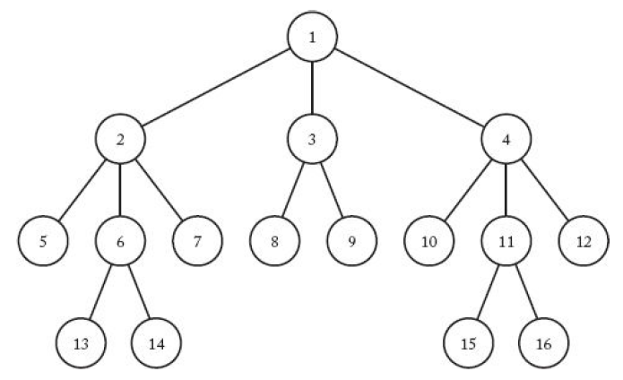

Slide 12
0-1 Knapsack Problem
First solution: Breadth-First Search with Branch-and-Bound Pruning
Let weight and profit be the total weight and total profit of the items that have been included up to a node

Slide 13
Breadth-First Search with Branch-and-Bound Pruning
Initialize totweight to weight and bound to profit
Greedily grab items
Add item’s weight to totwewight and items profit to bound
Until an item’s weight would bing totweight above W
Grab the fraction of the item allowed by available weight and add profit of the fraction to bound

Slide 14
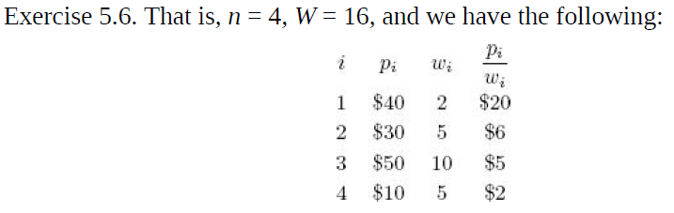
Determine if a mode is promising
A node is non-promising if this bound is <= maxprofit – the value of the best solution found up to that point
A node is also non-promising if weight >= W

Slide 15
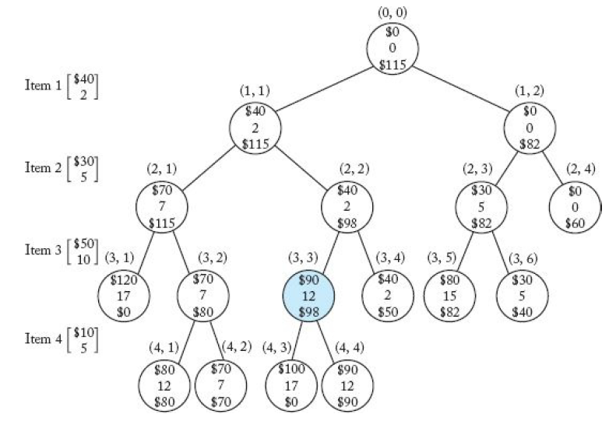
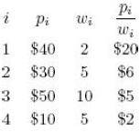
The pruned state space tree produced using breadth-first search with branch-and-bound pruning
n = 4, W = 16,

Slide 16
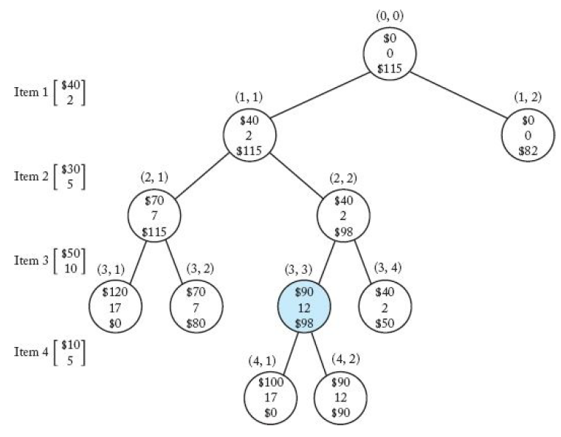
The pruned state space tree produced using best-first search with branch-and-bound pruning

Slide 17
Summary Branch-and-Bound
State space pruning
Breadth-first traversal of state space tree
Calculate a bound for a node
Bound best possible solution obtainable by expanding this node
Choose technique for calculating bound that produces best solution
If bound of a node not better than the best solution found so far or current node conditions exceed problem instance limits, do not expand the node

Slide 18
Summary Branch and Bound
BFS branch-and-bound pruning, decision on visiting node’s children is made at time node is visited. Maxprofit can change from time decision is made to visit until node is actually visited wasting time

Slide 19
Use bound to Improve Search
After visiting all of the children of a given node, expand the one with the best bound
Determine promising unexpanded node with greatest bound
Order determined by best bound rather than pre-determined
Use priority queue for implementation

Slide 20
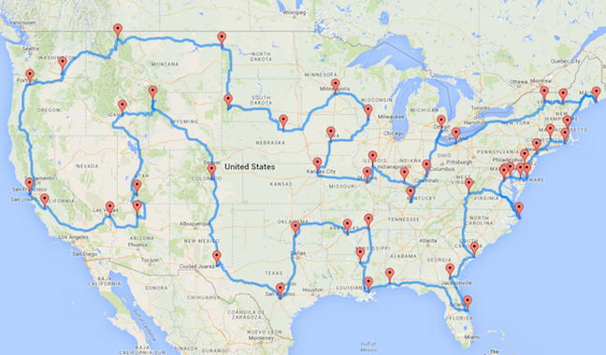
Traveling Salesperson Problem
Goal: find an optimal tour
Starts at a given city
Visits every city exactly once
Returns to the starting city
Such that the total distance travelled is minimal

Slide 21
Definitions
A walk in a network is a finite sequence of edges such that the end vertex of one edge is the start vertex of the next
A tour is a walk which visits every vertex, returning to its starting vertex.
A tour which visits every vertex exactly once is a Hamiltonian cycle.
The Travelling Salesman Problem involves finding a tour of minimum total weight.
In the classical problem, each vertex must be visited exactly once before returning to the start.
In the practical problem, each vertex must be visited at least once before returning to the start.

Slide 22
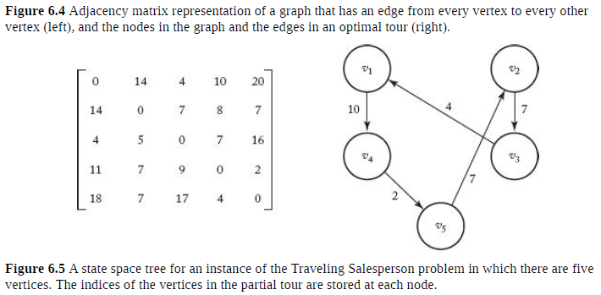
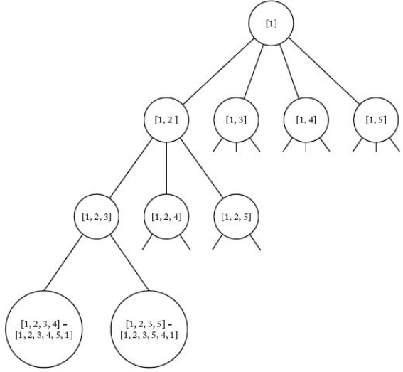

Slide 23
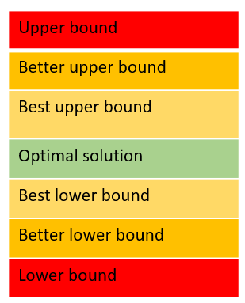
Bounds
There is no quick algorithm for solving The Travelling Salesman Problem, in most practical situations it is good enough to find a good solution, which may not be optimal.
We calculate ‘upper bounds’ and
‘lower bounds’ and use these
to trap the optimal solution.

Slide 24
Bound
Determine lower bound on the length of any tour obtainable by expanding beyond given node
Adjacency Matrix to represent distances between cities
Length of an edge taken when leaving a vertex >= length of the shortest edge leaving that vertex
Bound = cost of traveling the sub-path to arrive at node i plus the cost of the minimum sub-path to travel from the last vertex in the path back to vi
A node is non-promising of bound >= minlength

Slide 25
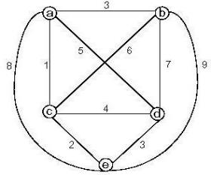
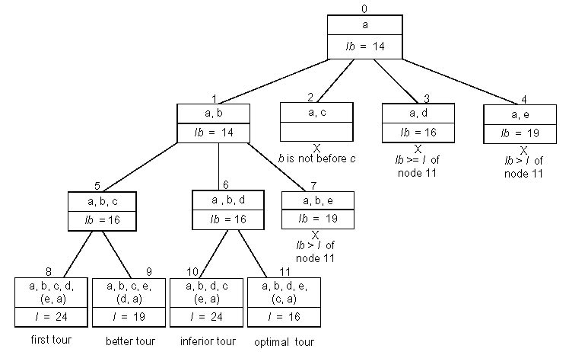
Example: Traveling Salesman Problem

Slide 26
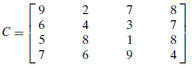
Assignment Problem
Select one element in each row of the cost matrix C so that:
no two selected elements are in the same column
the sum is minimized
Example
Job 1 Job 2 Job 3 Job 4
Person a 9 2 7 8
Person b 6 4 3 7
Person c 5 8 1 8
Person d 7 6 9 4
Lower bound: Any solution to this problem will have total cost at least: 2 + 3 + 1 + 4 (or 5 + 2 + 1 + 4)

Slide 27
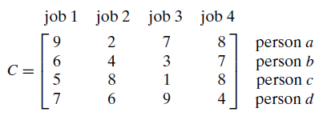
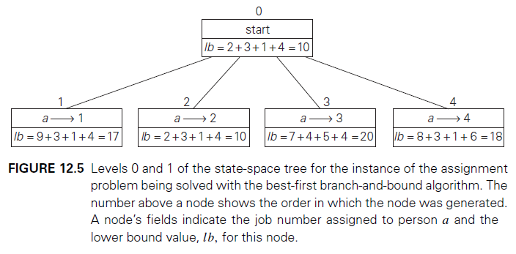
First two levels of the state-space tree

Slide 28
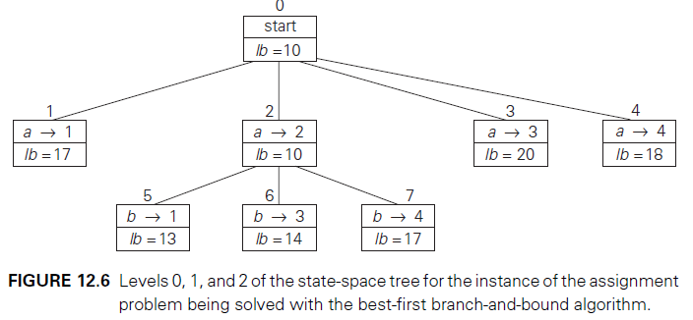
First three levels of the state-space tree

Slide 29
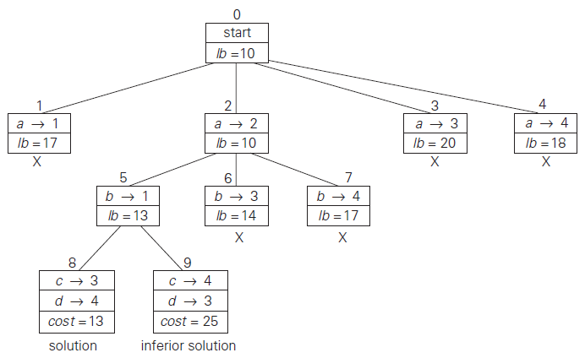
Complete state-space tree

Slide 30
Lower Bounds
Lower bound: an estimate on a minimum amount of work needed to solve a given problem
Examples:
number of comparisons needed to find the largest element in a set of n numbers
number of comparisons needed to sort an array of size n
number of comparisons necessary for searching in a sorted array
number of multiplications needed to multiply two n-by-n matrices

Slide 31
Lower Bounds (cont.)
Lower bound can be
an exact count
an efficiency class (Ω)
Tight lower bound: there exists an algorithm with the same efficiency as the lower bound
Problem Lower bound Tightness
sorting Ω(nlog n) yes
searching in a sorted array Ω(log n) yes
element uniqueness Ω(nlog n) yes
n-digit integer multiplication Ω(n) unknown
multiplication of n-by-n matrices Ω(n²) unknown

Slide 32
Methods for Establishing Lower Bounds
trivial lower bounds
information-theoretic arguments (decision trees)
adversary arguments
problem reduction

Slide 33
Trivial Lower Bounds
Trivial lower bounds: based on counting the number of items that must be processed in input and generated as output
Examples
finding max element
polynomial evaluation
sorting
element uniqueness
Hamiltonian circuit existence
Conclusions
may and may not be useful
be careful in deciding how many elements must be processed

Slide 34
Decision Trees
Decision tree — a convenient model of algorithms involving
comparisons in which:
internal nodes represent comparisons
leaves represent outcomes
Decision tree for 3-element insertion sort

Slide 35
Decision Trees and Sorting Algorithms
Any comparison-based sorting algorithm can be represented by a decision tree
Number of leaves (outcomes) ≥ n!
Height of binary tree with n! leaves ≥ ⎡log₂n!⎤
Minimum number of comparisons in the worst case ≥ ⎡log₂n!⎤ for any comparison-based sorting algorithm
⎡log₂n!⎤ ≈ n log₂n
This lower bound is tight (mergesort)

Slide 36
Adversary Arguments
Adversary argument: a method of proving a lower bound by
playing role of adversary that makes algorithm work the hardest
by adjusting input
Example 1: “Guessing” a number between 1 and n with yes/no
questions
Adversary: Puts the number in a larger of the two subsets generated by last question
Example 2: Merging two sorted lists of size n
a₁ < a₂ < … < a_{n} and b₁ < b₂ < … < b_{n}
Adversary: a_{i} < b_{j} iff i < j
Output b₁ < a₁ < b₂ < a₂ < … < b_{n} < a_{n} requires 2n-1 comparisons
of adjacent elements

Slide 37
Lower Bounds by Problem Reduction
Idea: If problem P is at least as hard as problem Q, then a lower
bound for Q is also a lower bound for P.
Hence, find problem Q with a known lower bound that can be reduced to problem P in question.
Example: P is finding MST for n points in Cartesian plane Q is element uniqueness problem (known to be in Ω(nlogn))

Slide 38
Problem Types: Optimization and Decision
Optimization problem: find a solution that maximizes or minimizes some objective function
Decision problem: answer yes/no to a question
Many problems have decision and optimization versions.
E.g.: traveling salesman problem
optimization: find Hamiltonian cycle of minimum length
decision: find Hamiltonian cycle of length ≤ m
Decision problems are more convenient for formal investigation of their complexity.

Slide 39
Transform and Conquer
This group of techniques solves a problem by a transformation to
a simpler/more convenient instance of the same problem (instance simplification)
a different representation of the same instance (representation change)
a different problem for which an algorithm is already available (problem reduction)

Slide 40
Instance simplification - Presorting
Solve a problem’s instance by transforming it into
another simpler/easier instance of the same problem
Presorting
Many problems involving lists are easier when list is sorted, e.g.
searching
computing the median (selection problem)
checking if all elements are distinct (element uniqueness)
Also:
Topological sorting helps solving some problems for dags.
Presorting is used in many geometric algorithms.

Slide 41
How fast can we sort ?
Efficiency of algorithms involving sorting depends on
efficiency of sorting.
Theorem (see Sec. 11.2): ⎡log₂ n!⎤ ≈ n log₂ n comparisons are necessary in the worst case to sort a list of size n by any comparison-based algorithm.
Note: About nlog₂ n comparisons are also sufficient to sort array of size n (by mergesort).

Slide 42
Searching with presorting
Problem: Search for a given K in A[0..n-1]
Presorting-based algorithm:
Stage 1 Sort the array by an efficient sorting algorithm
Stage 2 Apply binary search
Efficiency: Θ(nlog n) + O(log n) = Θ(nlog n)
Good or bad?
Why do we have our dictionaries, telephone directories, etc. sorted?

Slide 43
Element Uniqueness with presorting
Presorting-based algorithm
Stage 1: sort by efficient sorting algorithm (e.g. mergesort)
Stage 2: scan array to check pairs of adjacent elements
Efficiency: Θ(nlog n) + O(n) = Θ(nlog n)
Brute force algorithm Compare all pairs of elements Efficiency: O(n²)
Another algorithm? Hashing

Slide 44
Instance simplification – Gaussian Elimination
Given: A system of n linear equations in n unknowns with an arbitrary coefficient matrix. Transform to: An equivalent system of n linear equations in n unknowns with an upper triangular coefficient matrix. Solve the latter by substitutions starting with the last equation and moving up to the first one. a₁₁x₁ + a₁₂x₂ + … + a_{1n}x_{n} = b₁ a_{1,1}x₁+ a₁₂x₂ + … + a_{1n}x_{n} = b₁
a₂₁x₁ + a₂₂x₂ + … + a_{2n}x_{n} = b₂ a₂₂x₂ + … + a_{2n}x_{n} = b₂
a_{n1}x₁ + a_{n2}x₂ + … + a_{nn}x_{n} = b_{n} a_{nn}x_{n} = b_{n}

Slide 45
Gaussian Elimination (cont.)
The transformation is accomplished by a sequence of elementary operations on the system’s coefficient matrix (which don’t change the system’s solution): for i ←1 to n-1 do replace each of the subsequent rows (i.e., rows i+1, …, n) by a difference between that row and an appropriate multiple of the i-th row to make the new coefficient in the i-th column of that row 0

Slide 46
Example of Gaussian Elimination
Solve 2x₁ - 4x₂ + x₃ = 6 3x₁ - x₂ + x₃ = 11 x₁ + x₂ - x₃ = -3 Gaussian elimination
2 -4 1 6 2 -4 1 6
3 -1 1 11 row2 – (3/2)*row1 0 5 -1/2 2
1 1 -1 -3 row3 – (1/2)*row1 0 3 -3/2 -6 row3–(3/5)*row2
2 -4 1 6
0 5 -1/2 2
0 0 -6/5 -36/5
Backward substitution
x₃ = (-36/5) / (-6/5) = 6
x₂ = (2+(1/2)*6) / 5 = 1
x₁ = (6 – 6 + 4*1)/2 = 2

Slide 47
Pseudocode and Efficiency of Gaussian Elimination
Stage 1: Reduction to an upper-triangular matrix
for i ← 1 to n-1 do
for j ← i+1 to n do for k ← i to n+1 do A[j, k] ← A[j, k] - A[i, k] * A[j, i] / A[i, i] //improve!
Stage 2: Back substitutions for j ← n downto 1 do
t ← 0
for k ← j +1 to n do
t ← t + A[j, k] * x[k] x[j] ← (A[j, n+1] - t) / A[j, j]
Efficiency: Θ(n³) + Θ(n²) = Θ(n³)

Slide 48
Problem Reduction
This variation of transform-and-conquer solves a problem by a transforming it into different problem for which an algorithm is already available.
To be of practical value, the combined time of the transformation and solving the other problem should be smaller than solving the problem as given by another method.

Slide 49
Examples of Solving Problems by Reduction
computing lcm(m, n) via computing gcd(m, n)
counting number of paths of length n in a graph by raising the graph’s adjacency matrix to the n-th power
transforming a maximization problem to a minimization problem and vice versa (also, min-heap construction)
linear programming
reduction to graph problems (e.g., solving puzzles via state-space graphs)

